Slide 1
Automation of departmental stores management store management system

Slide 2
DESIGN DIAGRAMS
TEAM – 4
K.T.L. KALAIVANI -16IT041
(scrum master)
K. MEENADEVI - 16IT052 S. MUKILA - 16IT056 S. SALAI PRIYA SELVI - 16IT087

Slide 3
DATAFLOW DIAGRAMS

Slide 4
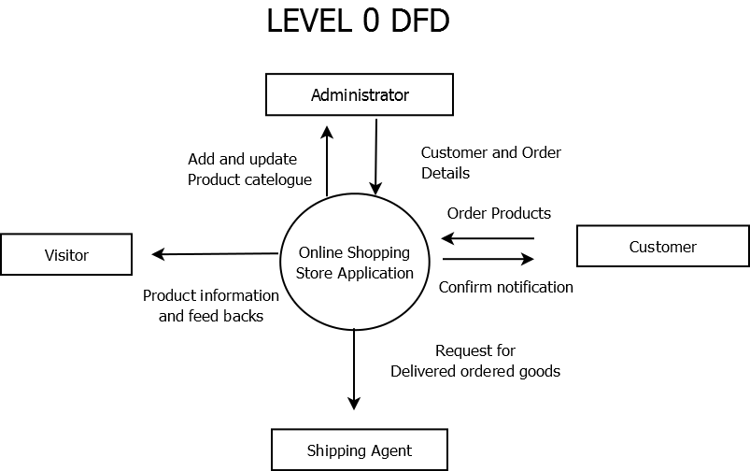
LEVEL 0 DFD

Slide 5
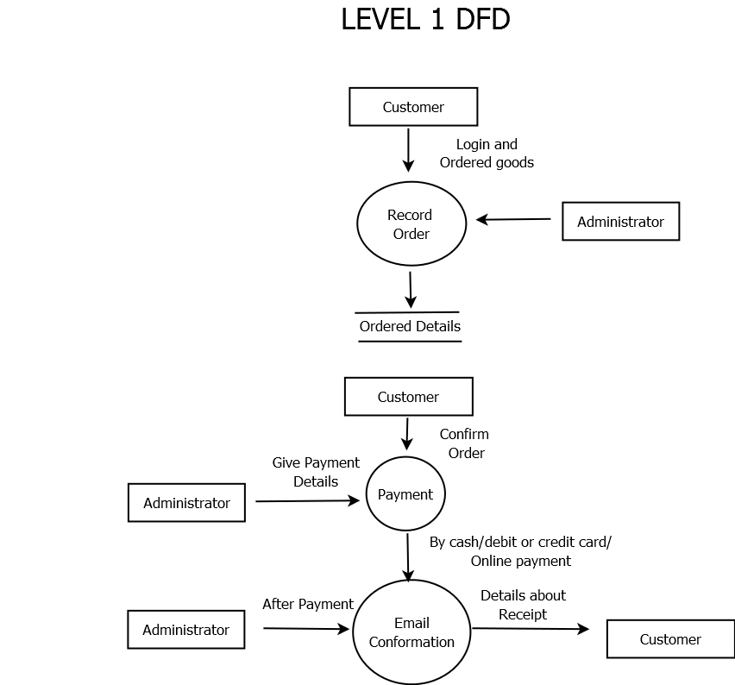
LEVEL 1 DFD

Slide 6
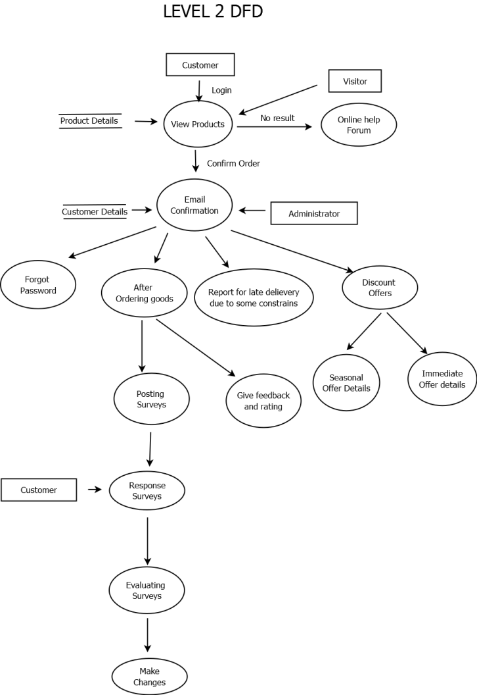
LEVEL 2 DFD

Slide 7
UML DIAGRAMS

Slide 8
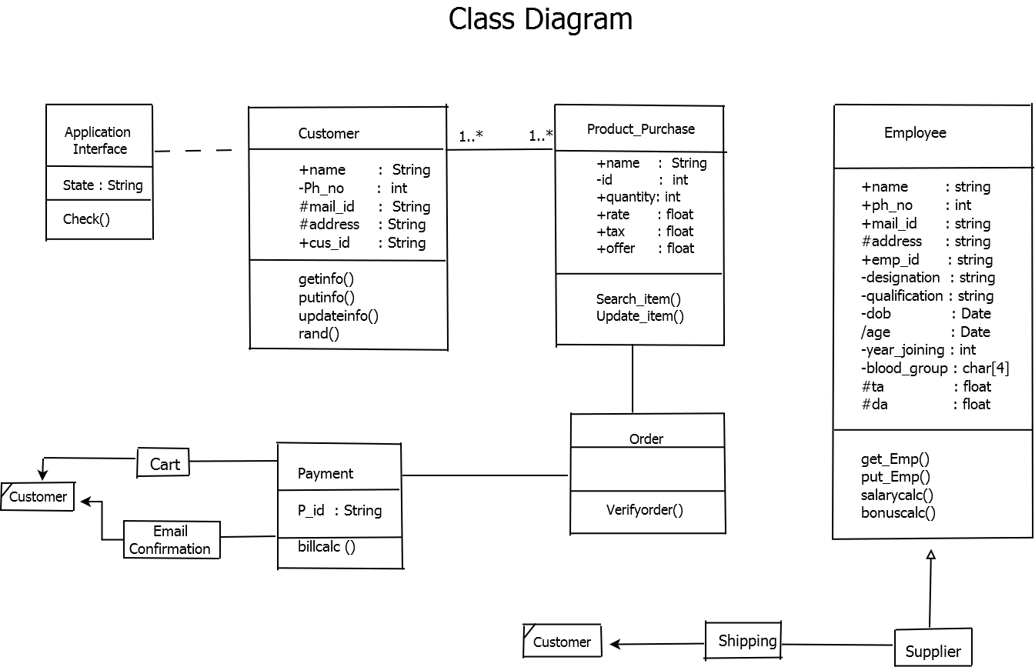
CLASS DIAGRAM

Slide 9
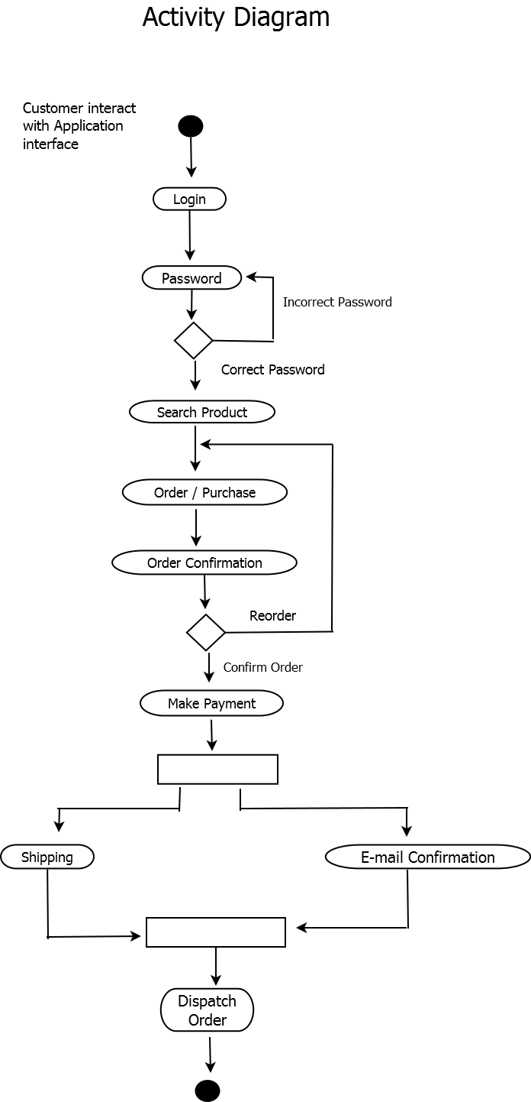
ACTIVITY DIAGRAM

Slide 10
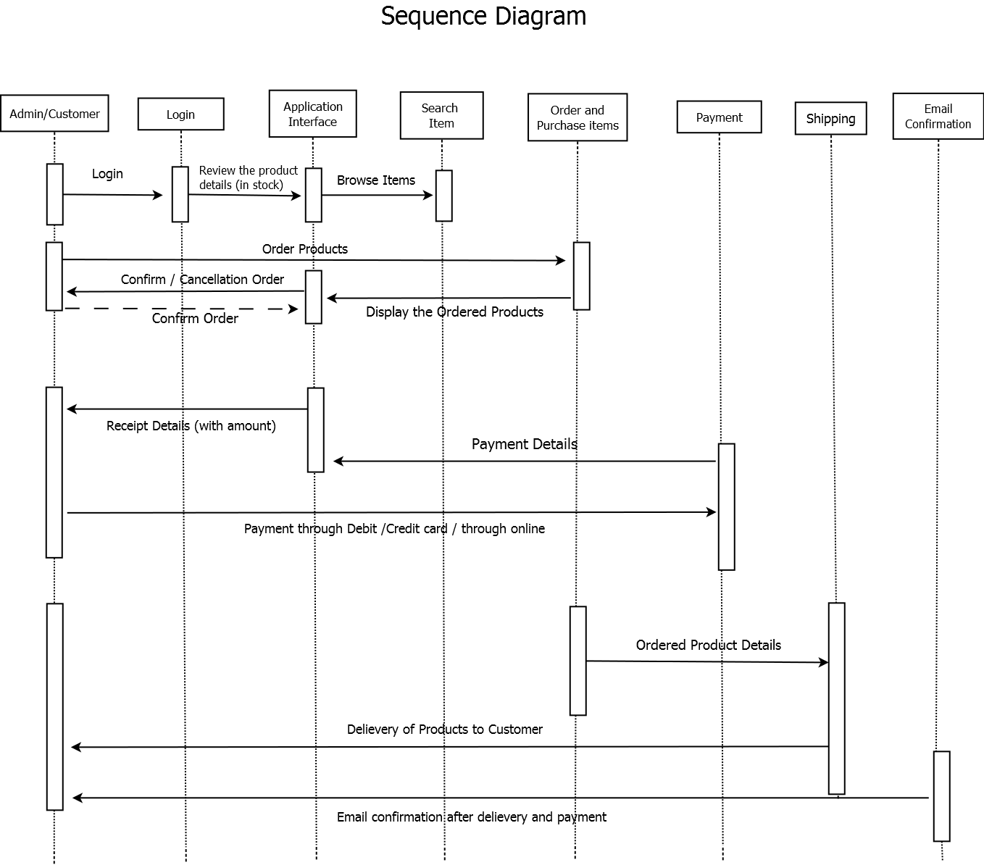
SEQUENCE DIAGRAM

Slide 11
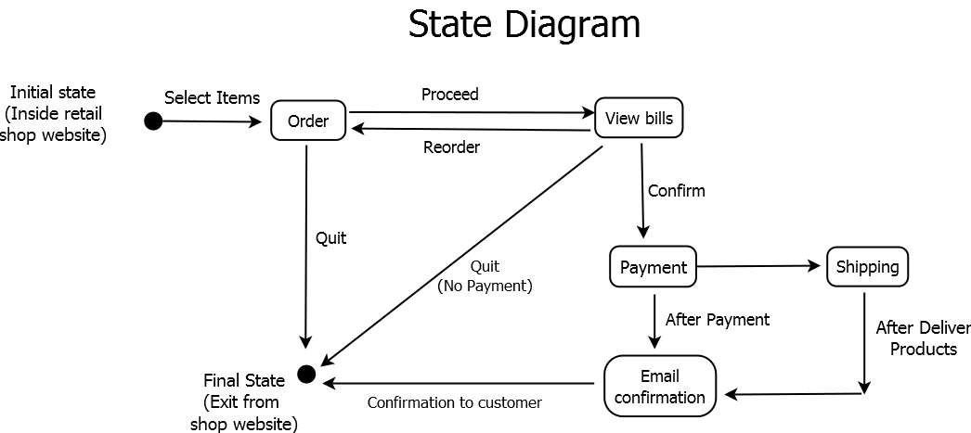
STATE MACHINE DIAGRAM

Slide 12
USER INTERFACE DESIGN

Slide 13
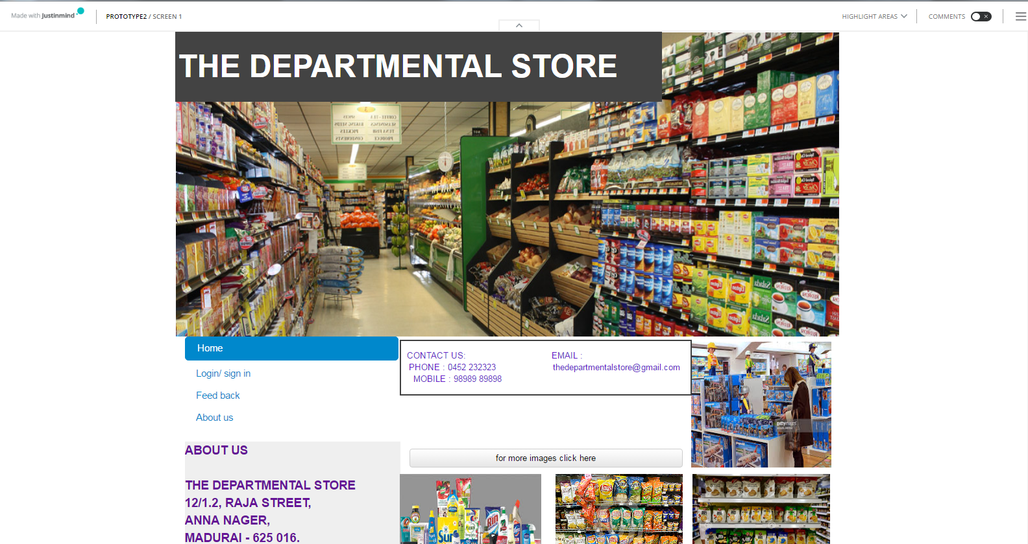
FRONT PAGE…

Slide 14
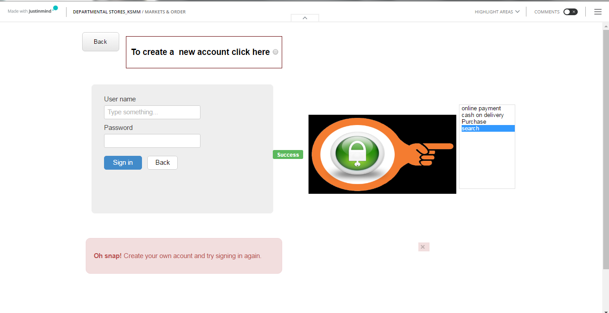
LOGIN PAGE…

Slide 15
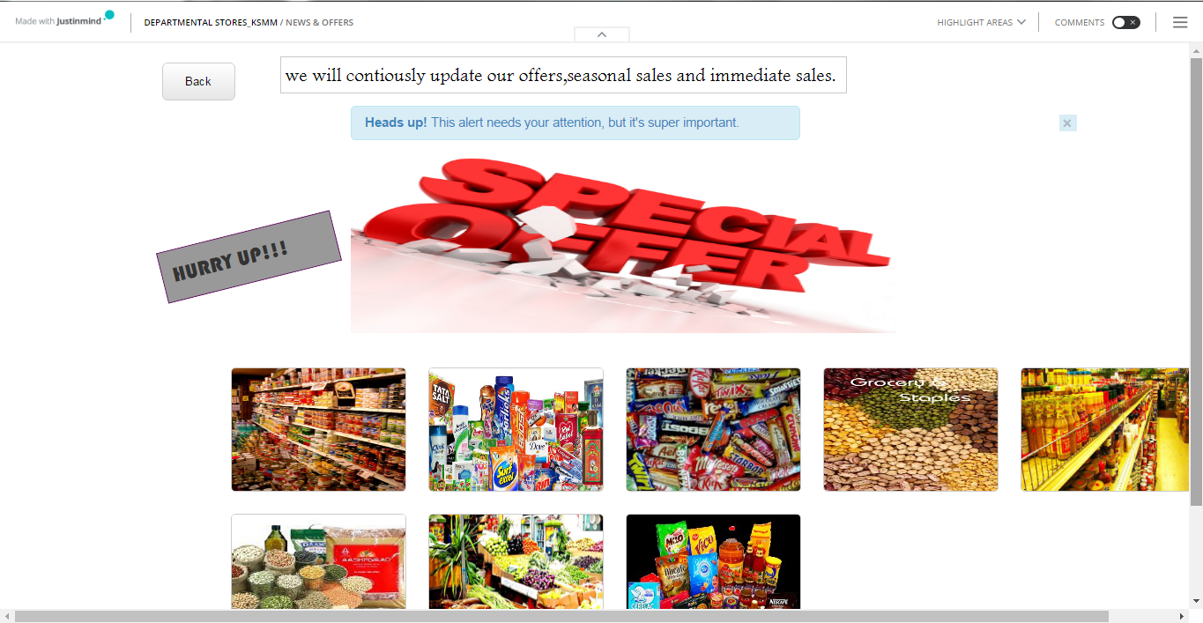
OFFER DETAILS…

Slide 16
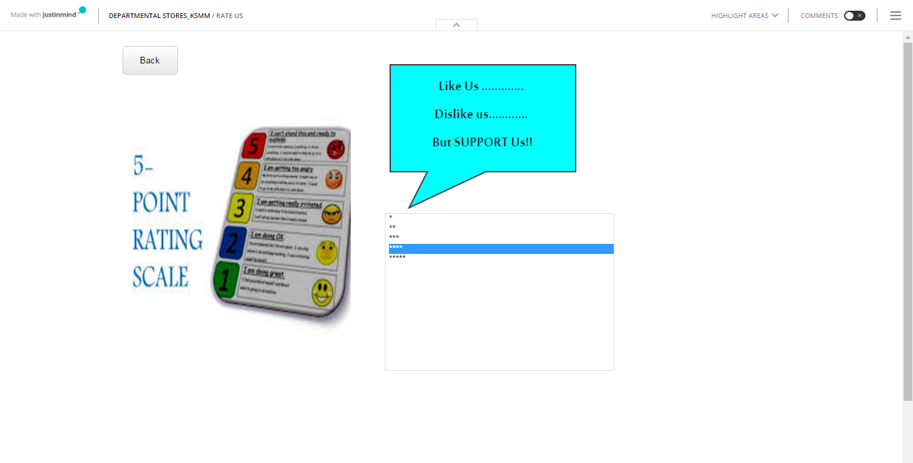
RATING…

Slide 17
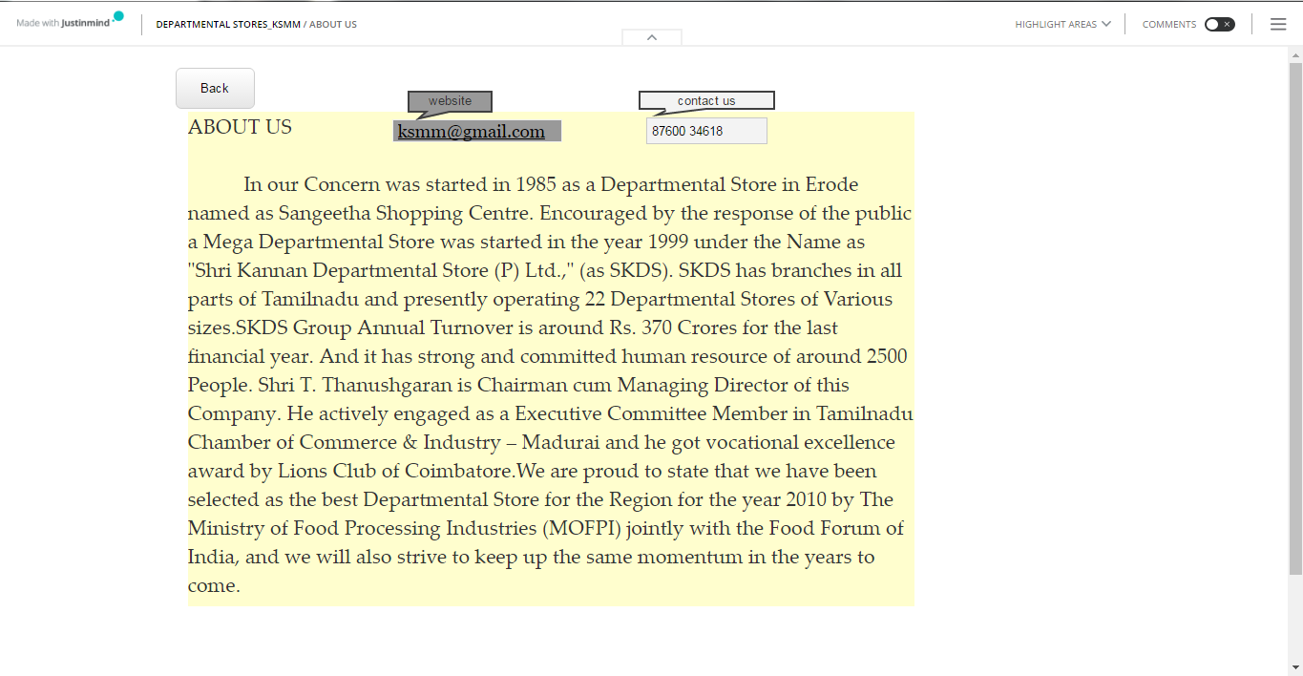
ABOUT US…

